Slide 1
SECURE DATA HIDING IN IMAGES USING STEGANOGRAPHY
CAPSTONE PROJECT
Presented By : Aruna Kotte
Student Name : Aruna Kotte
College Name & Department : KGRL College ( Adikavi Nannaya University) & Master of Computer Applications (M.C.A)

Slide 2
OUTLINE
Problem Statement
Technology used
Wow factor
End users
Result
Conclusion
Git-hub Link
Future scope

Slide 3
Problem Statement
In today’s digital world, keeping data safe is a big challenge, especially when it comes to images and text. This project focuses on encrypting and decrypting both, ensuring only authorized users can access the original content. Using Python, we’ll implement strong encryption methods to protect sensitive data. The goal is to make security simple yet effective for real-world applications.

Slide 4
Technology used
Securing text and image data is crucial to prevent unauthorized access. This project uses Python with OpenCV and OS libraries to encrypt and decrypt images and text efficiently. The encryption process transforms data into an unreadable format, which can only be recovered with the correct key. This ensures enhanced security for personal and confidential information across different platforms.”

Slide 5
Wow factors
Data security is a top priority, especially for sensitive text and images. This project, powered by Python with OpenCV and OS libraries, brings a cutting-edge encryption and decryption system to safeguard data like never before. By converting images and text into a cryptic format, only the right key can unlock their true form. It’s not just security—it’s digital invisibility at your command!”

Slide 6
End users
1. Cybersecurity Enthusiasts & Researchers
2. Journalists & Activists
3. Developers & IT Professionals
4. Businesses & Enterprises
5. Students & Educators
6. Photographers & Designers

Slide 7
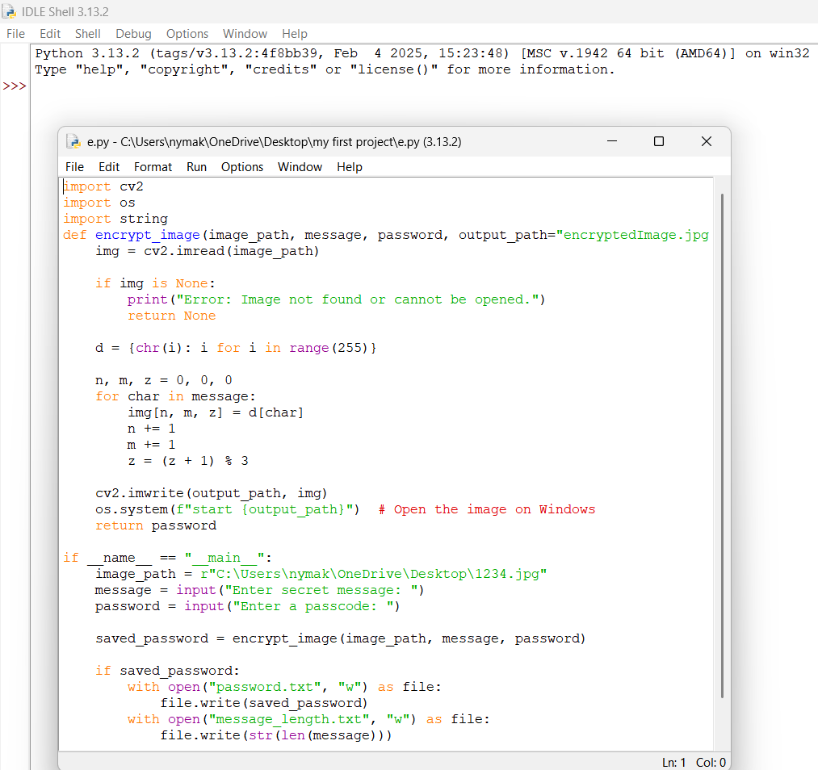
Results

Slide 8
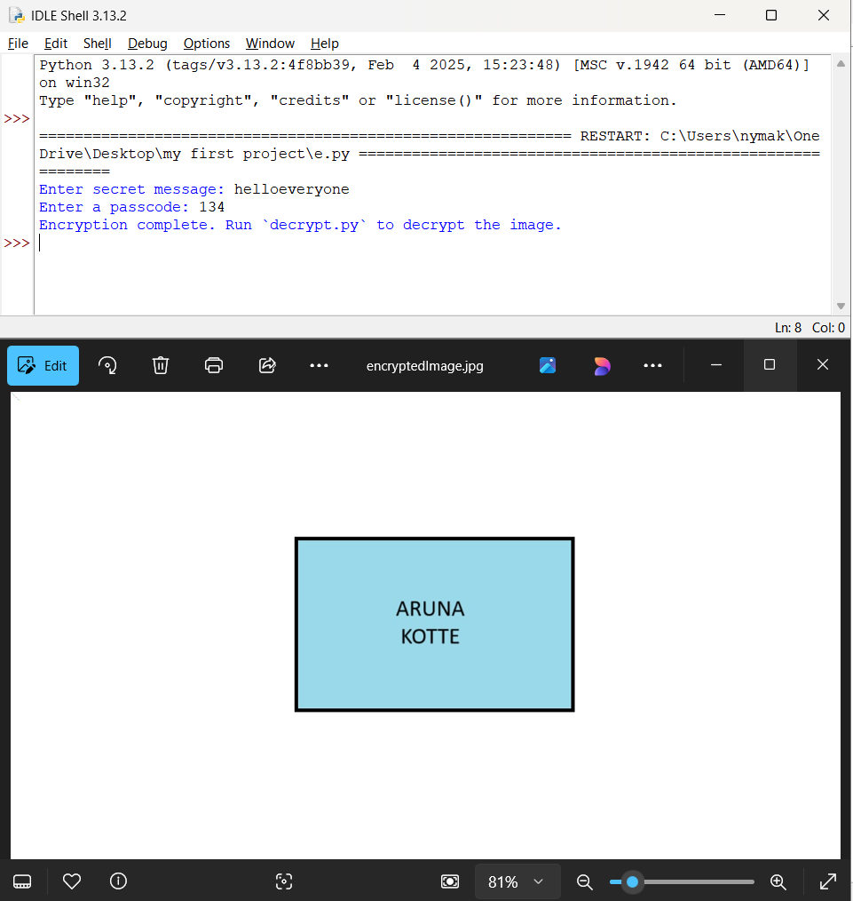
Results

Slide 9
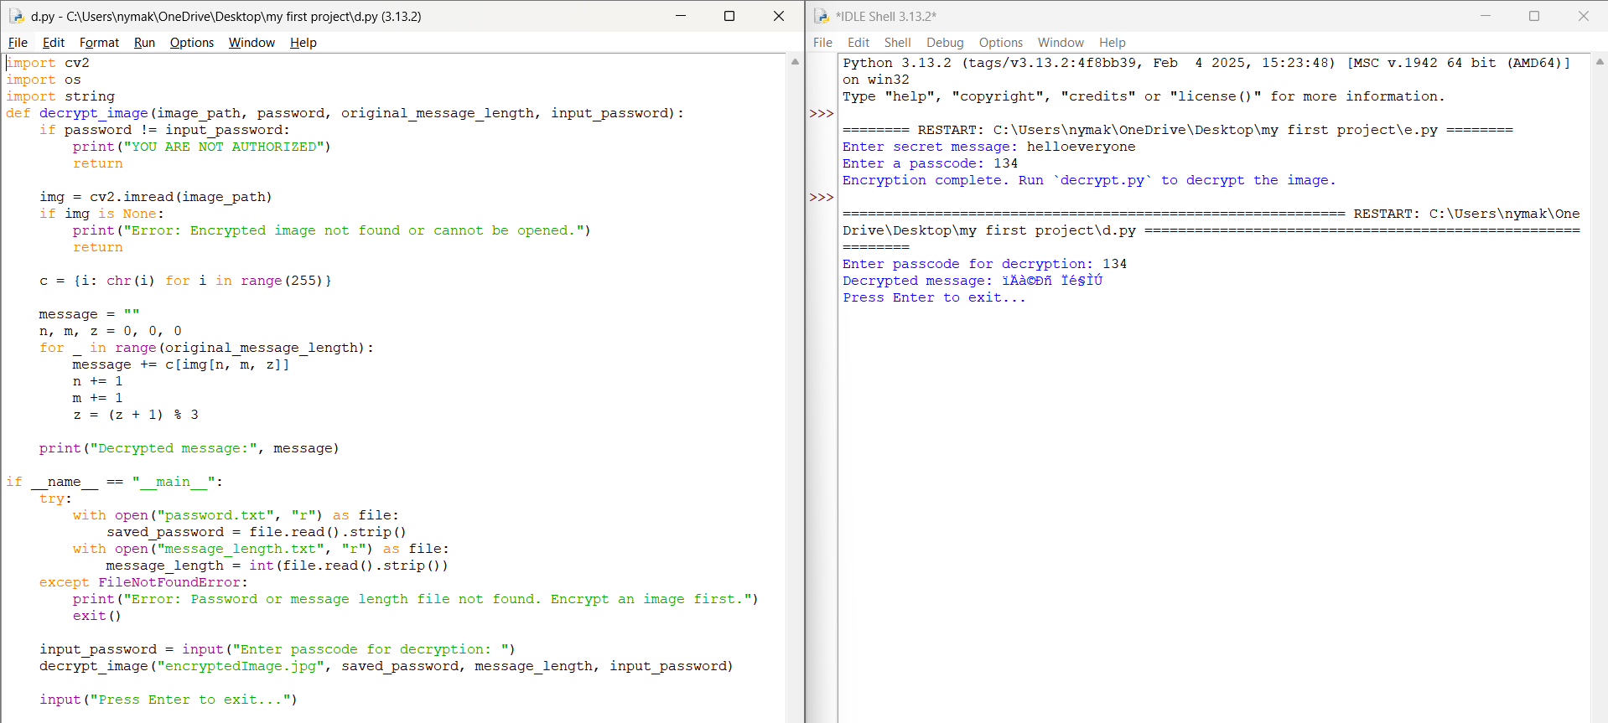
Results

Slide 10
Conclusion
This project successfully addresses the challenge of securing sensitive text and image data using Python, OpenCV, and OS libraries. By implementing robust encryption and decryption techniques, it ensures that only authorized users can access the original content. The system enhances data confidentiality, making it ideal for personal, professional, and enterprise use. With its efficiency and security, this solution provides a practical approach to safeguarding digital information in today’s cyber-threat landscape.

Slide 11
GitHub Link
https://github.com/Arunakotte/SECURE-DATA-HIDING-IN-IMAGES-USING-STEGANOGRAPHY.git

Slide 12
Future scope(optional)
1.Cloud & Blockchain Integration
2. GUI Development
3. Multi-Layer Encryption
4. Mobile App Development

Slide 13
THANK YOU

